Slide 1

REDBUS DATA SCRAPING WITH SELENIUM &DYNAMIC FILTERING USING STREAMLIT
Submitted by
Mathesh M

Slide 2
Agenda
1
2
3
4
5
Introduction
Problem statement
Solution Approach
VISUALIZATION
CONCLUSION

Slide 3
Introduction
Develop a web scraper to automate the extraction of bus route details, schedules, and relevant information from the RedBus website for multiple states. Store the data in an SQL database and visualize it using a Streamlit app.

Slide 4
Problem statement
The "Redbus Data Scraping and Filtering with Streamlit Application" aims to revolutionize the transportation industry by providing a comprehensive solution for collecting, analyzing, and visualizing bus travel data. By utilizing Selenium for web scraping, this project automates the extraction of detailed information from Redbus, including bus routes, schedules, prices, and seat availability. By streamlining data collection and providing powerful tools for data-driven decision-making, this project can significantly improve operational efficiency and strategic planning in the transportation industry.

Slide 5
SOLUTION APPROACH
WEB SCRAPPING (SELENIUM)
SQL DATABASE INTEGRATION (MY SQL CONNECTOR)
STREAMLIT APP DEVELOPMENT (STREAMLIT)
DATA ANALYSIS /FILTERING USING STREAMLIT

Slide 6
WEB SCRAPPING
Initialize Web Driver: Open and maximize the browser, and navigate to the RedBus website.
Load Web Page: Load the specific URL for the target state, handling any loading delays.
Scrape Bus Routes: Identify and extract all bus route links and names on the page, managing pagination to capture all routes.
Scrape Bus Details: Navigate to each bus route link and extract detailed information about available buses, such as name, type, departing time, duration, reaching time, star rating, price, and seat availability.
Handle Errors: Implement error handling for missing elements or loading failures, logging errors and continuing the scraping process.

Slide 7
SQL DATABASE INTEGRATION.
Data Cleaning:The code defines functions to clean and standardize the data in columns like "Total_duration", "Price", "Seats_Available", and "Ratings".
Data Preparation:code applies the cleaning functions to the dataframe, cleaning and preparing the data for insertion
Database Connection:The code establishes a connection to the MySQL database using the provided credentials.
Data Insertion:
The code iterates through each row in the cleaned dataframe.
It executes an SQL INSERT statement to insert the data into the "bus_routes" table, mapping the dataframe columns to the corresponding table columns.
V. Error Handling:
The code incorporates try-except blocks to handle potential errors during data cleaning, database connection, and insertion.

Slide 8
STREAMLIT APP DEVELOPMENT
Setup Streamlit:
Install Streamlit (pip install streamlit).
Create a Streamlit script (app.py).
Database Connection:
Use mysql-connector to connect to the database.
Query and Display Data:
Fetch data from the database and use Streamlit components to display it.
Add Filters and Analysis:
Use Streamlit widgets to add filters for route name, bus type, etc.
Use Streamlit to analyse data

Slide 9
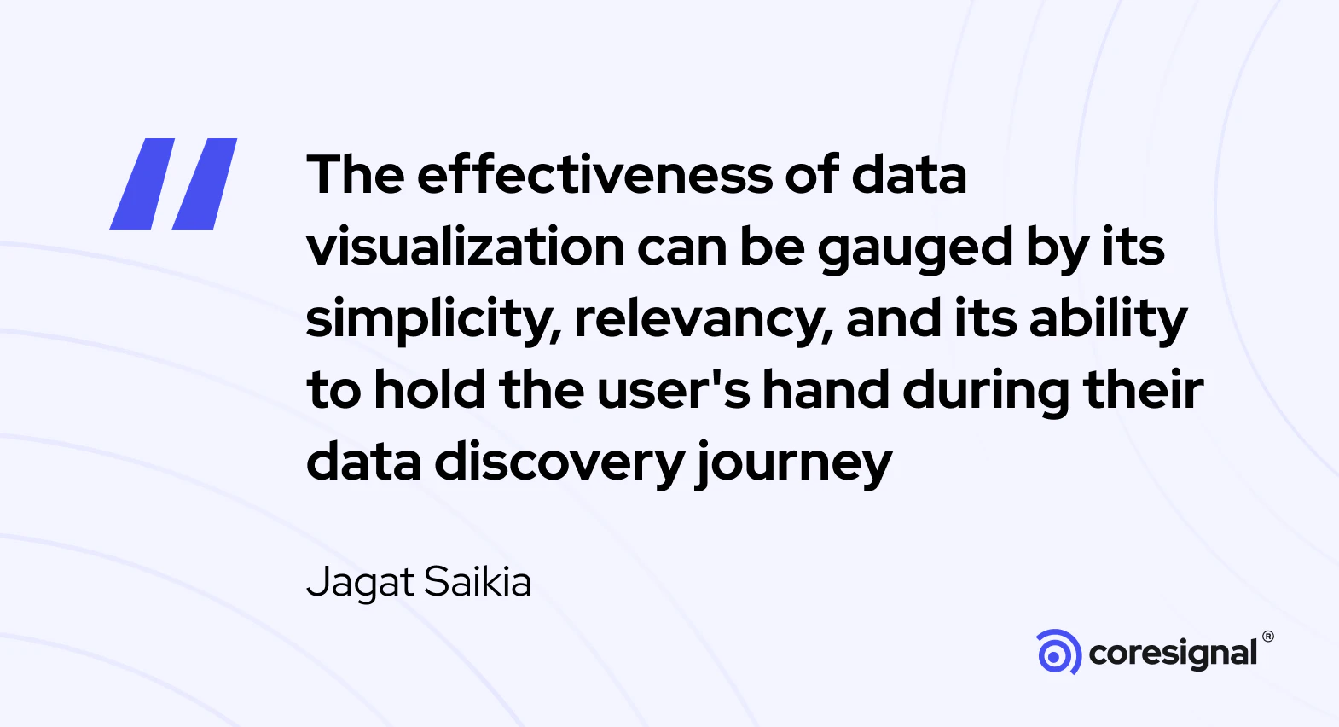

Slide 10
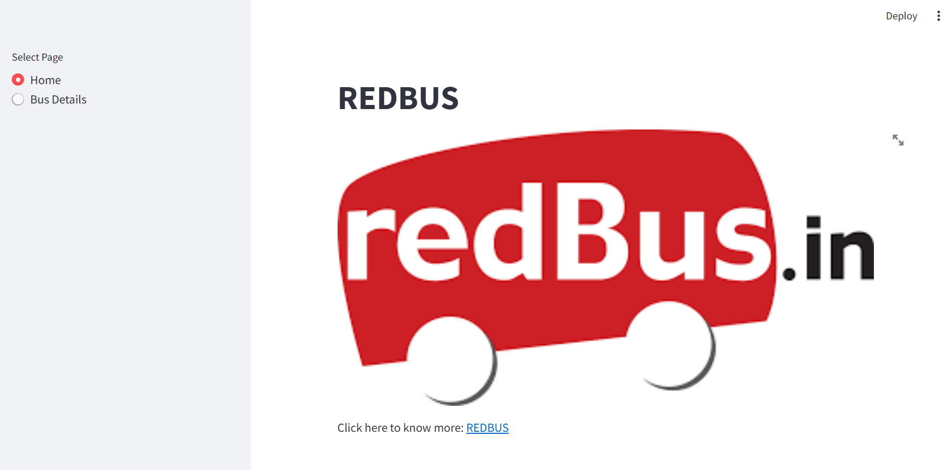

Slide 11
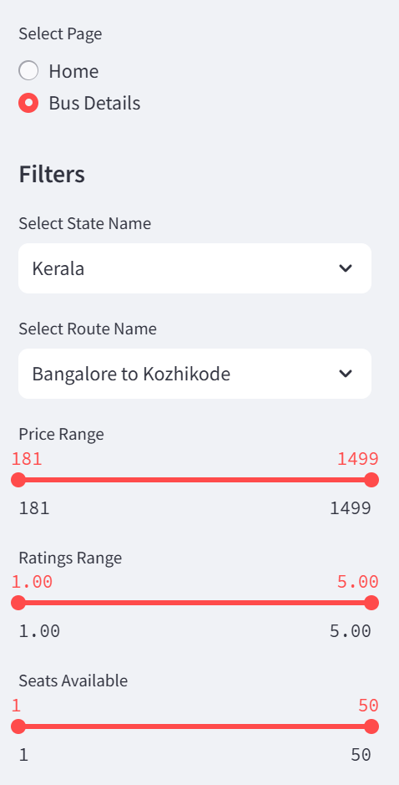
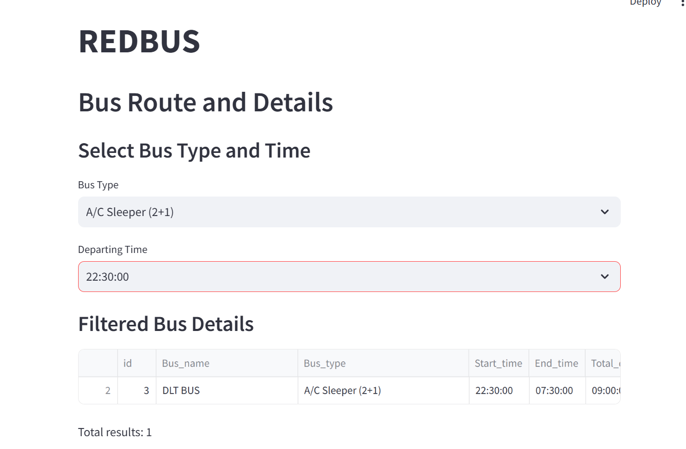

Slide 12
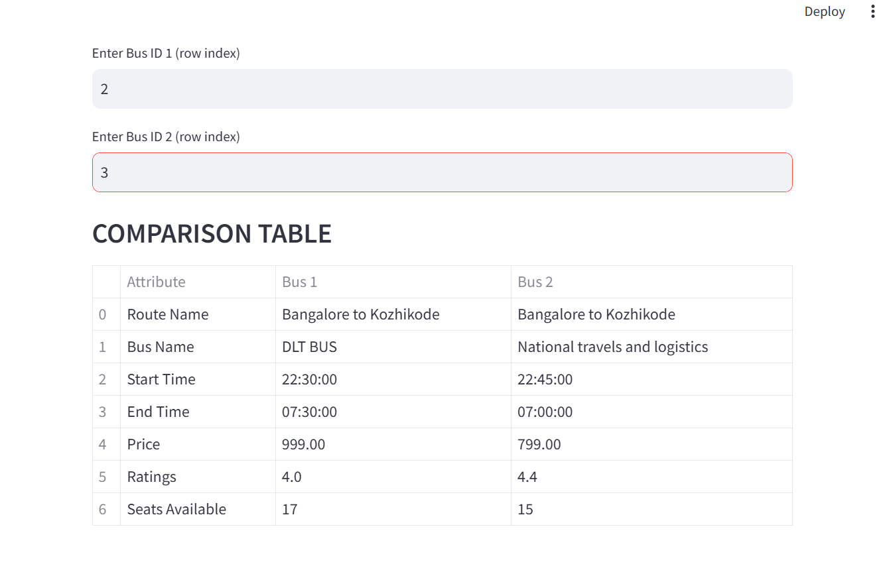

Slide 13
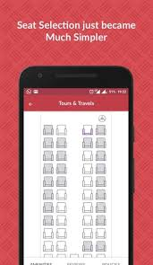
CONCLUSION
The "Redbus Data Scraping and Filtering with Streamlit Application" effectively addresses the challenges faced by the transportation industry by providing a comprehensive solution for data collection, analysis, and visualization. By automating the process of extracting bus route information using Selenium, the project significantly enhances operational efficiency and enables data-driven decision-making. The Streamlit application further empowers users to explore and filter the data, facilitating market analysis, customer service improvements, and competitive intelligence. The successful implementation of this project demonstrates the potential of leveraging technology to revolutionize the transportation sector.

Slide 14


Thank you

